Slide 1
Initial Results Check-In

Slide 2
Summary-Sediment and Abiotic Variables
Merged USGS and Thesis Sediment Deposition data into one dataframe!
Thesis includes additional variables:
“local slope”
Extrapolated from marsh edge horizontal profile (June 2025) to the most recent RTK surveys of the transect (Nov. 2025-March 2025)
mean wind speed
Calculated per site, spanning time of Day filter was placed-Day filter was collected
USGS includes additional variables and elements:
Bay (Transects A, B) and Channel (Transects C, D) incorporated in data frames
Calculated z* to pair with thesis measurements
Used same BCDC stations as Thesis for standardization

Slide 3
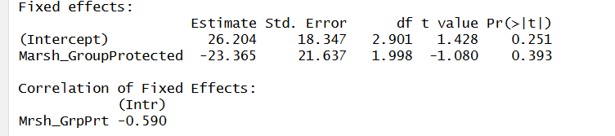
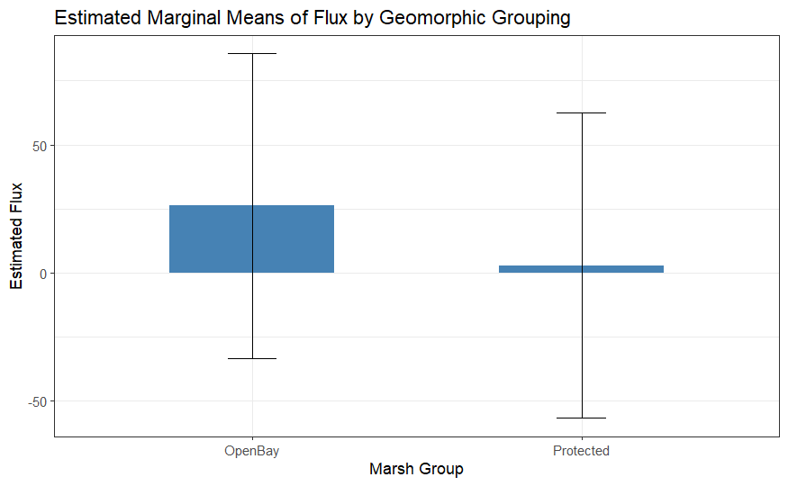
RQ # 1-Does marsh edge matter for sediment deposition?
Spatially
lmer(Flux ~ Marsh_Group + (1 | Site) + (1 | Tran), data = marsh_group_flux)
“Open Bay” = San Pablo and Giant Marsh
“Protected” = Buck’s Landing and Corte Madera

Slide 4
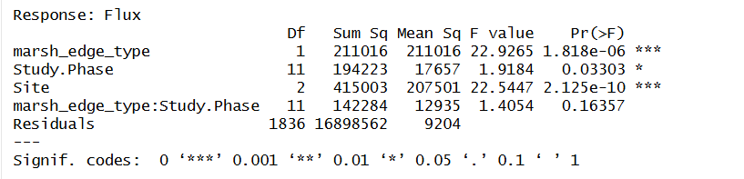
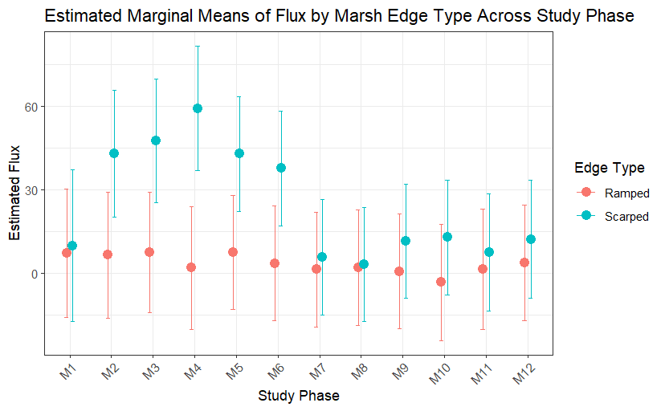
RQ # 1-Does marsh edge matter for sediment deposition?
Temporally-All Sites
lm(Flux ~ marsh_edge_type * Study.Phase + Site

Slide 5
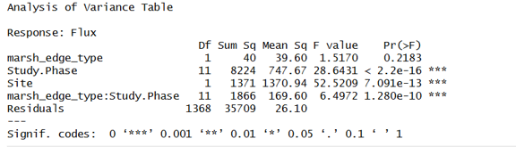
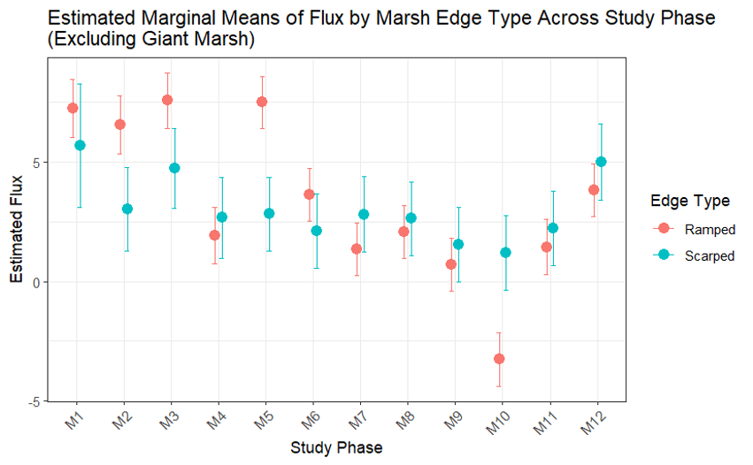
RQ # 1-Does marsh edge matter for sediment deposition?
Temporally-Excluding Giant Marsh
lm( Flux ~ marsh_edge_type * Study.Phase + Site

Slide 6
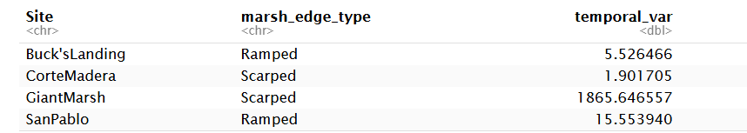
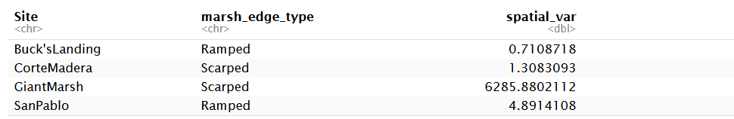
RQ # 1-Does marsh edge matter for sediment deposition?
Variance Between Sites
Temporally (Per Study Phase)
Spatially (Per Distance from Marsh Edge)

Slide 7
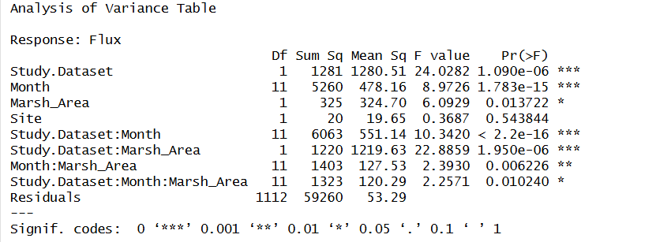
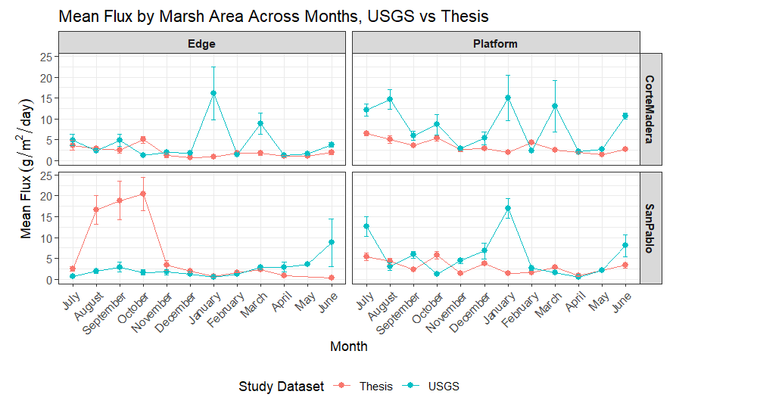
RQ #2: Do rates of sediment deposition change over time at the same edge type?
Spatially
lm( Flux ~ Study.Dataset * Month * Marsh_Area + Site

Slide 8
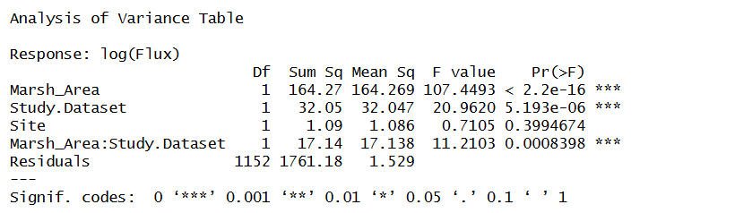
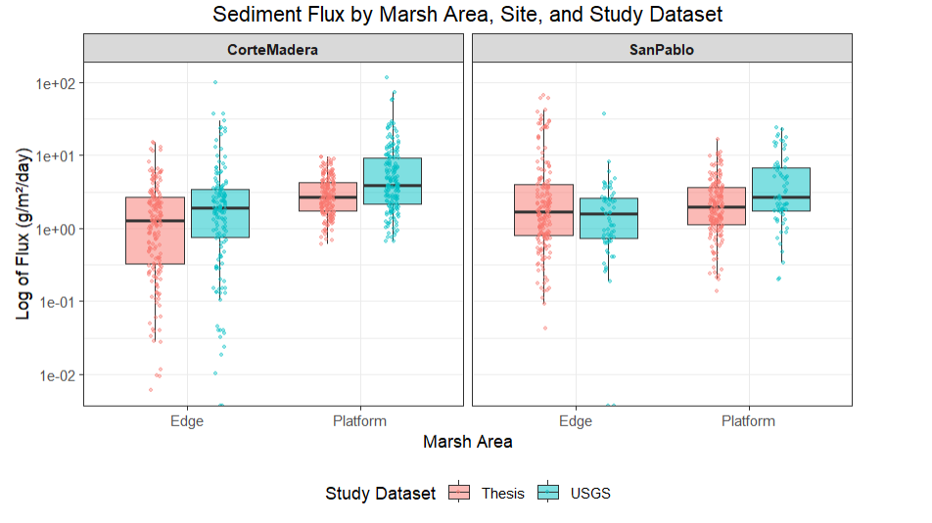
RQ #2: Do rates of sediment deposition change over time at the same edge type?
Spatially
lm(formula = log(Flux) ~ Marsh_Area * Study.Dataset + Site

Slide 9
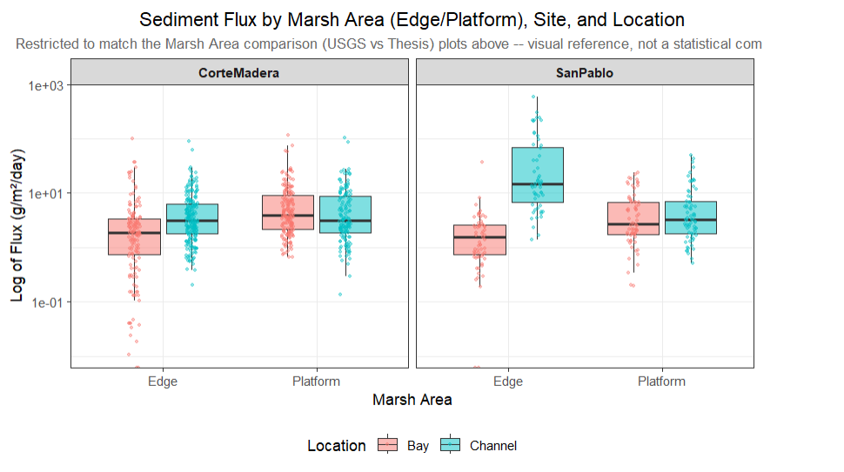
RQ #2: 2022/2023 Bay and Channel Transects

Slide 10
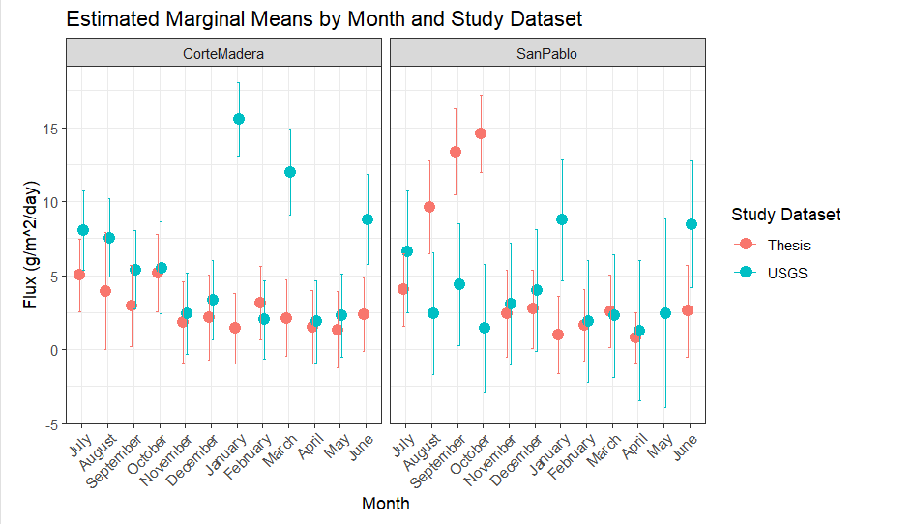
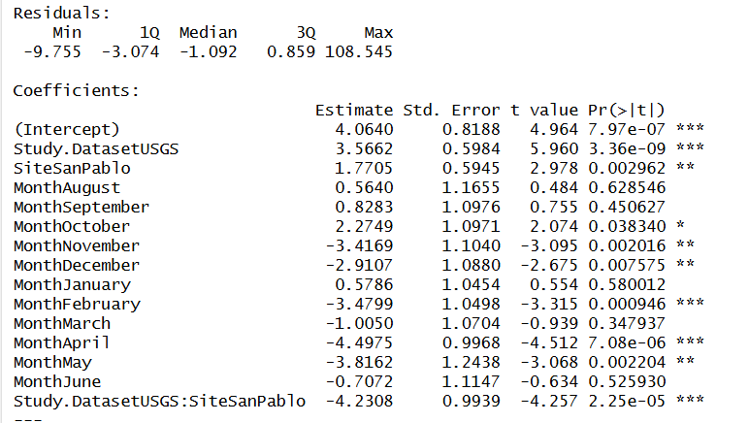
RQ #2: Do rates of sediment deposition change over time at the same edge type?
Temporally
lm( Flux ~ Study.Dataset *Site + Month

Slide 11
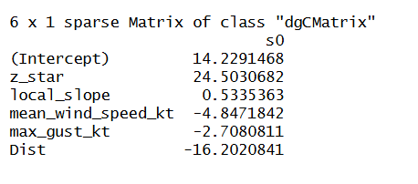
RQ# 3: Do inter-marsh variables explain more of the differences between sediment deposition?
LASSO (Least Absolute Shrinkage and Selection Operator) First Attempt (Thorne 2022).
Tried it out but still need to work through the theory of it.
Variables selected Against Flux. All predictors were standardized to zero for scaling.
Z star
Local Slope
Mean wind speed
Max gust
Distance from edge

Slide 12
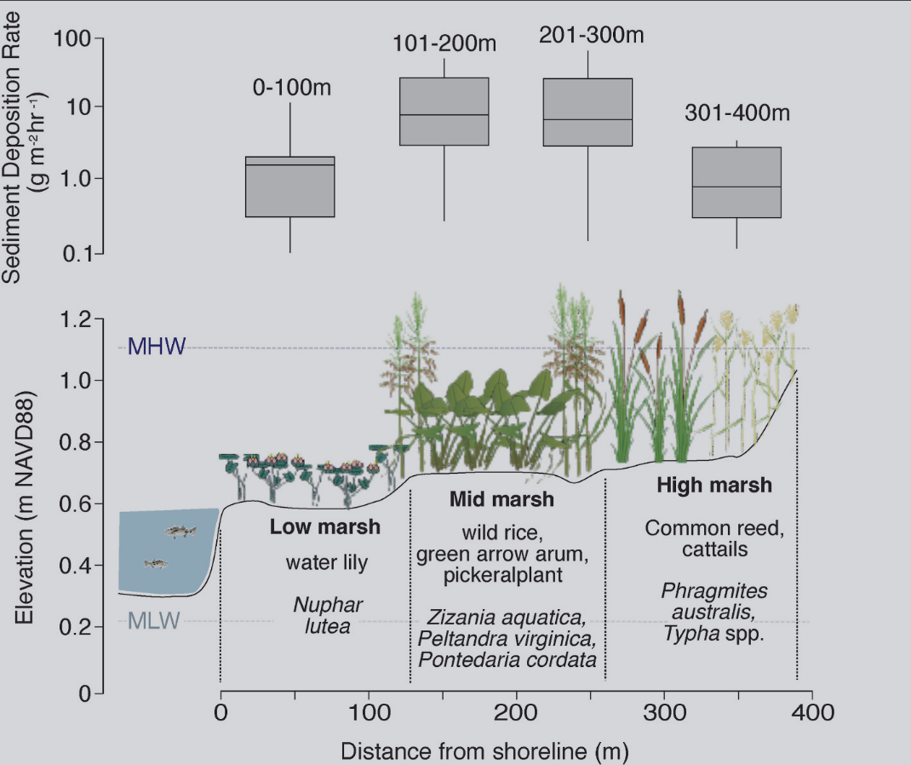
Appendices (Descriptive Data): Vegetation
Merged USGS and Thesis Vegetation data into one dataframe
Includes average height, maximum height, percent cover (per majority species, and for S. pacifica (SAPA) and S. foliosa (SPFO)
Only includes sediment data from the day of Winter and Summer Collections
Idea is to see if I can have an image with marsh profile and vegetation in one graph, such as the Echiejile 2025 (Time dependence of sediment accretion rates: Short- and long-term variability in an urban tidal marsh).

Slide 13
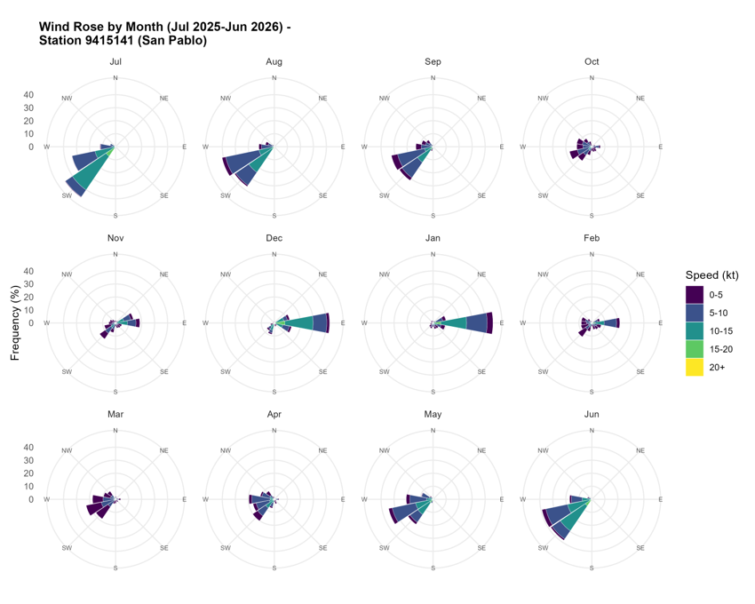
Appendices (Descriptive Data): Wind Direction

Slide 14
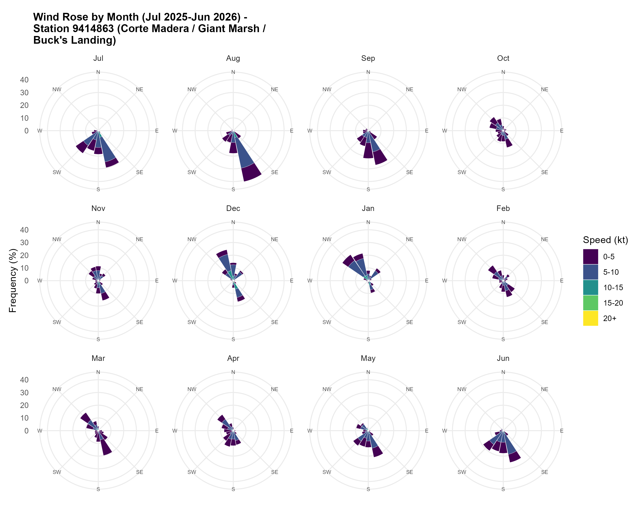
Appendices (Descriptive Data): Wind Direction

Slide 15
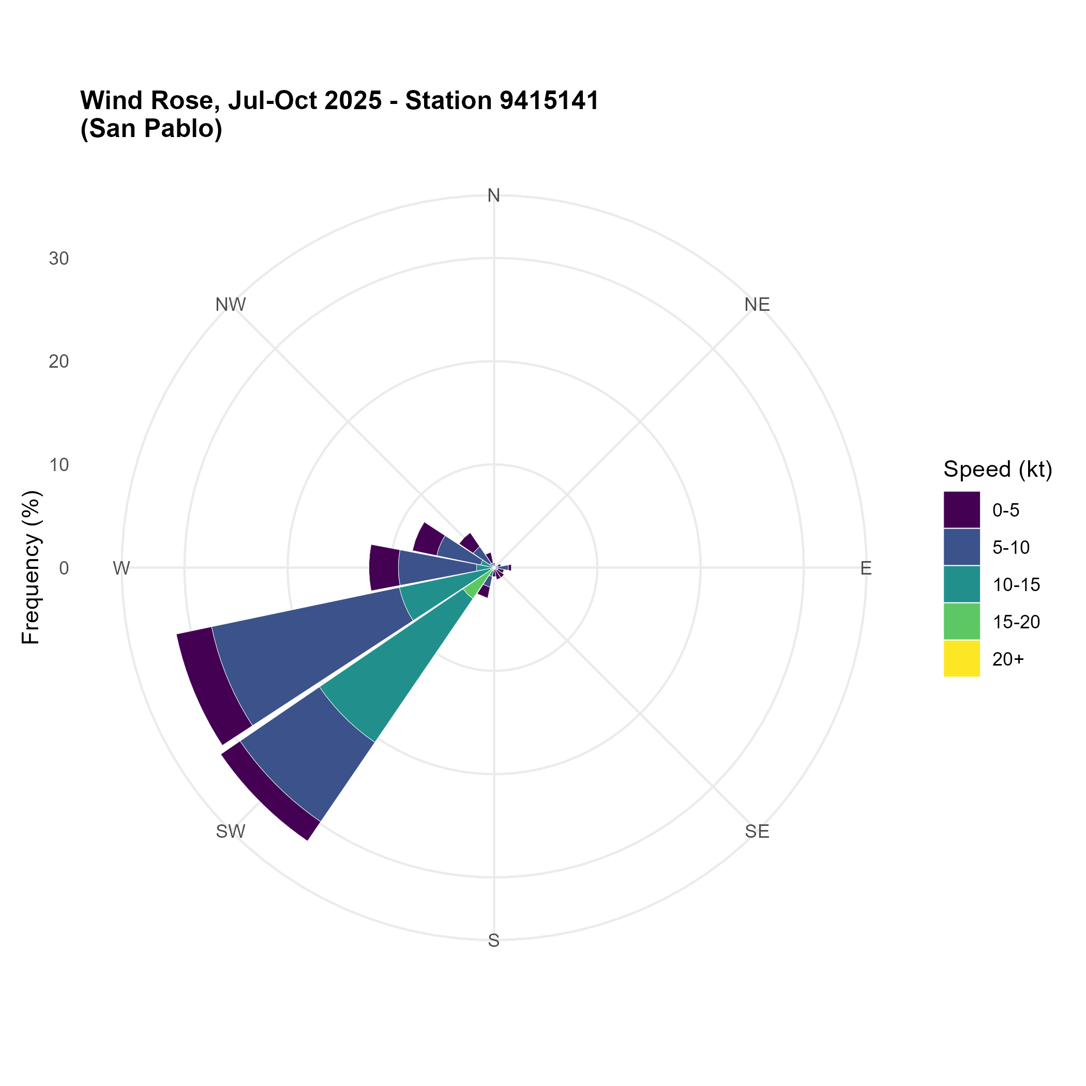
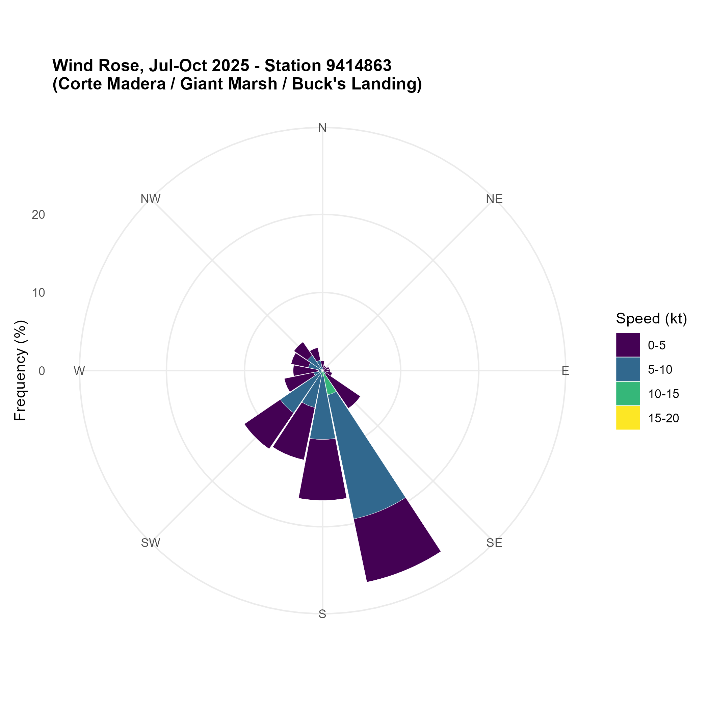
Appendices (Descriptive Data): Wind Direction
July-October 2025

Slide 16
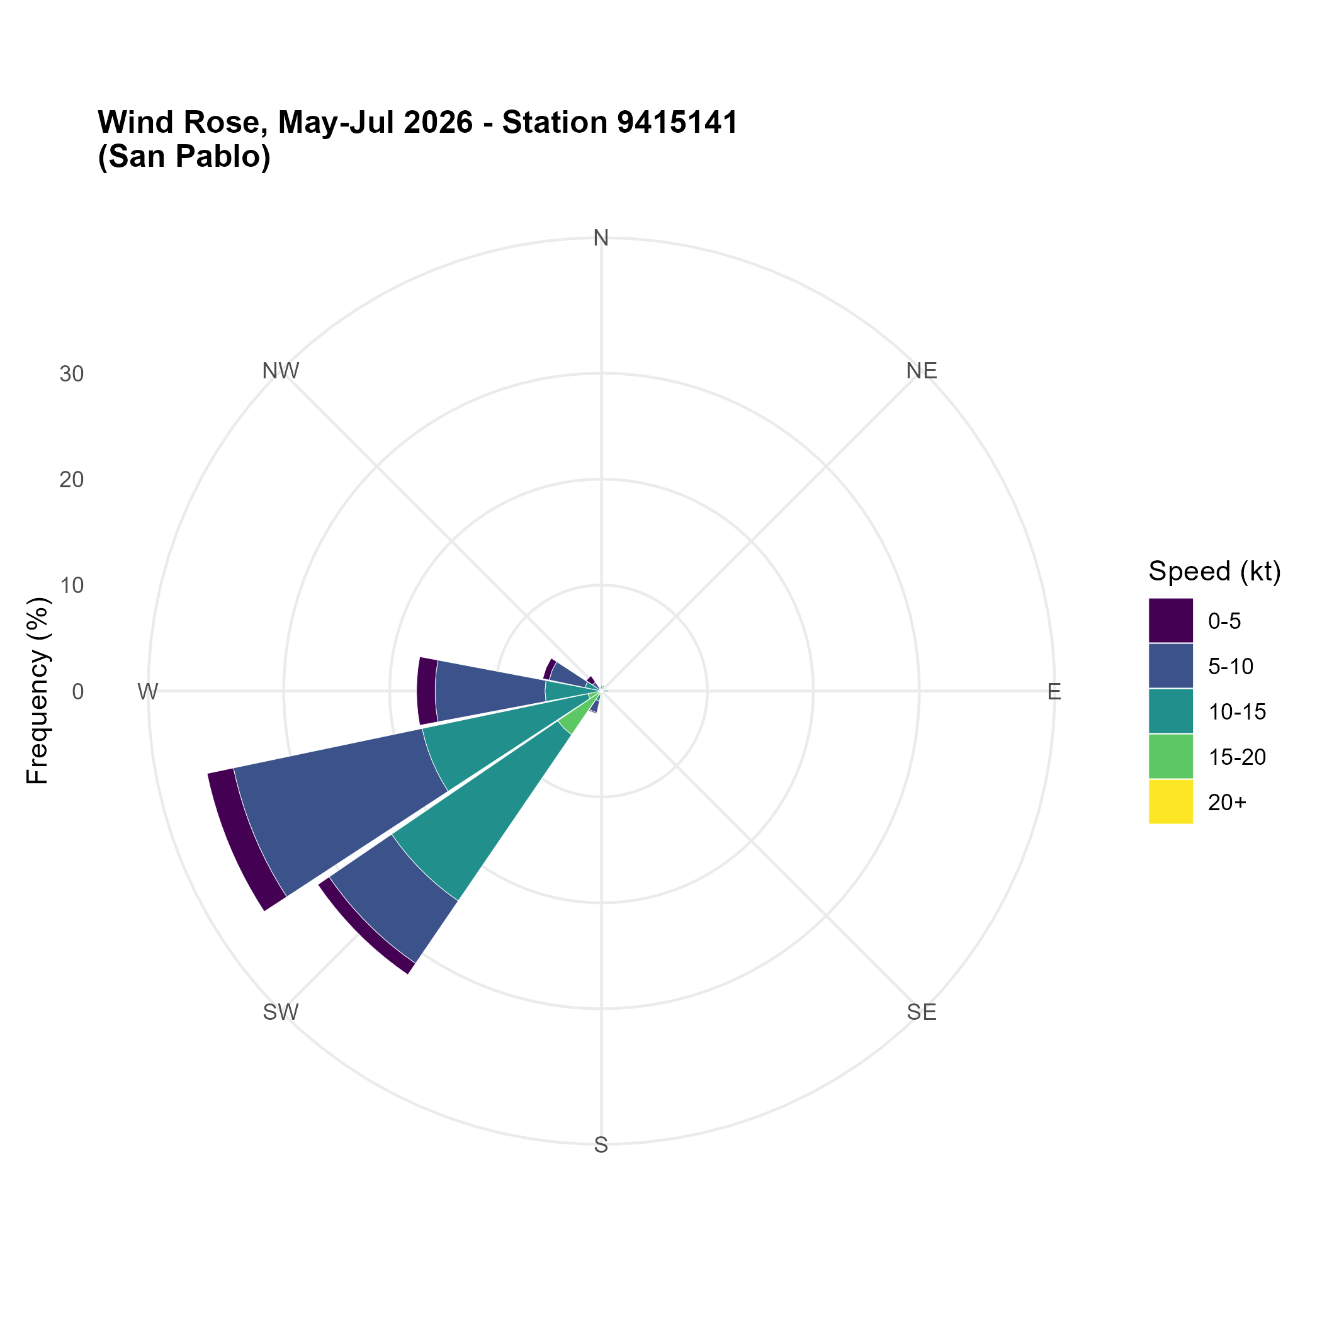
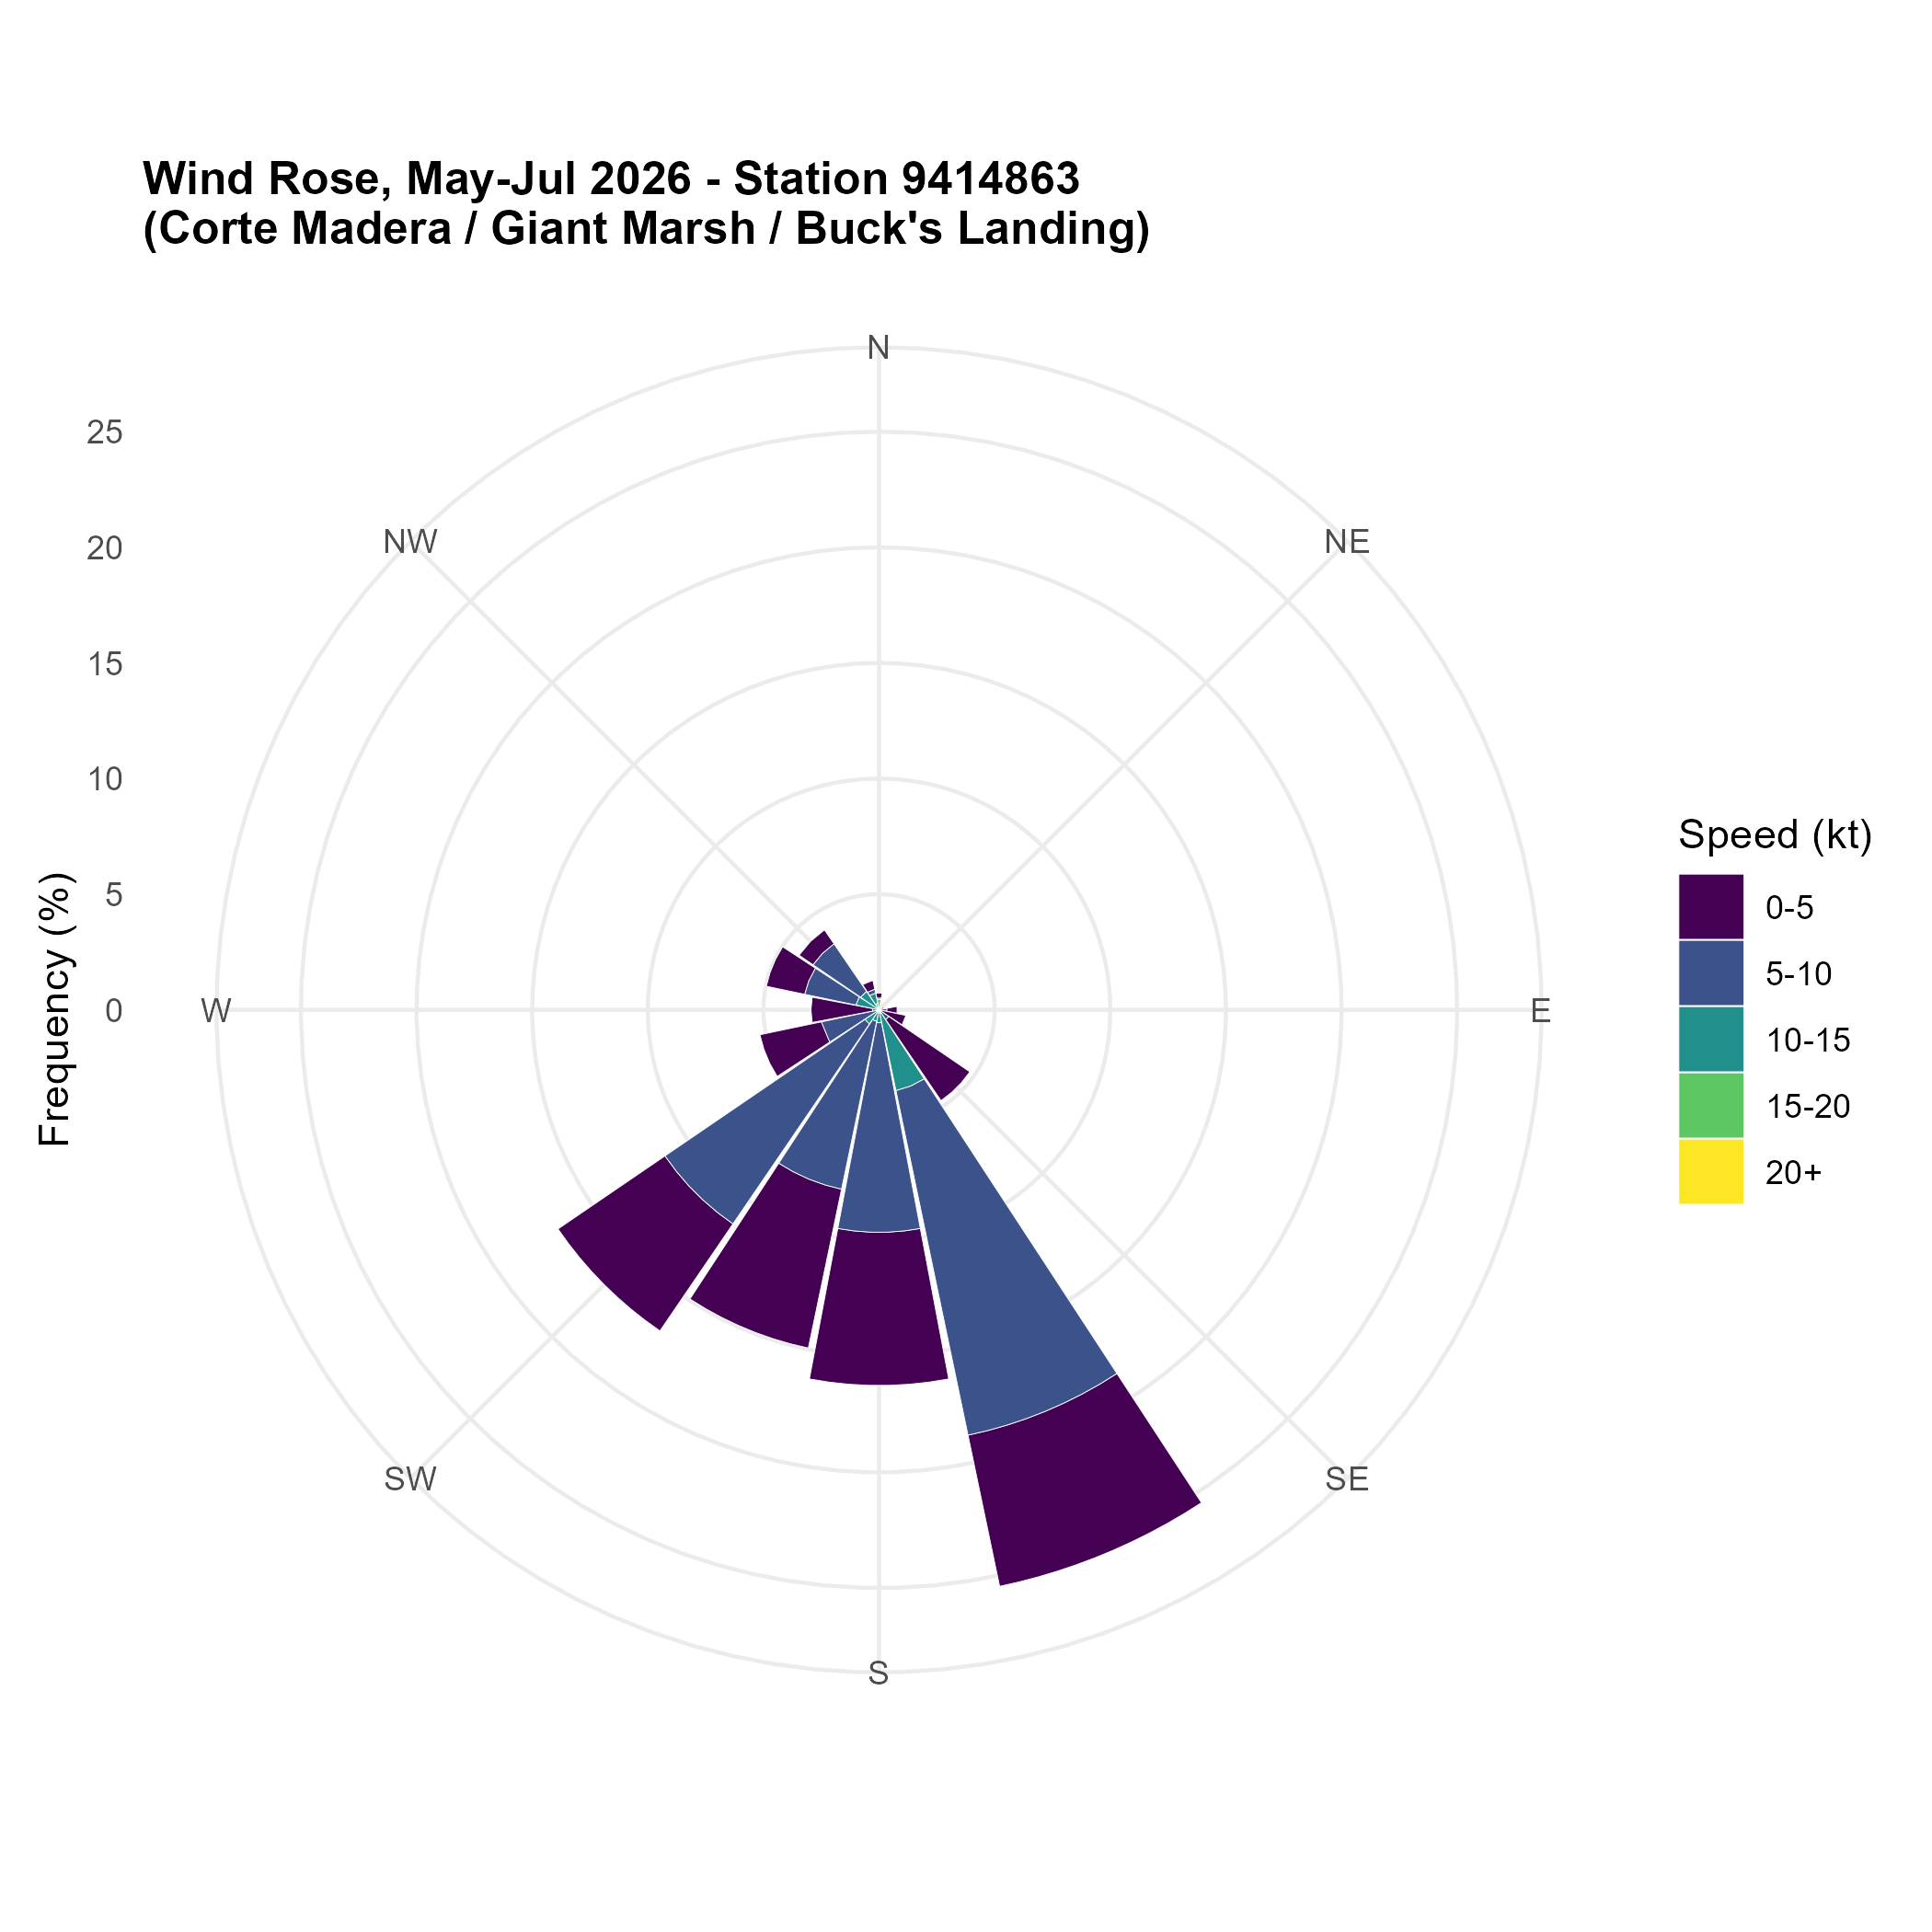
Appendices (Descriptive Data): Wind Direction
May-August 2026

Slide 17
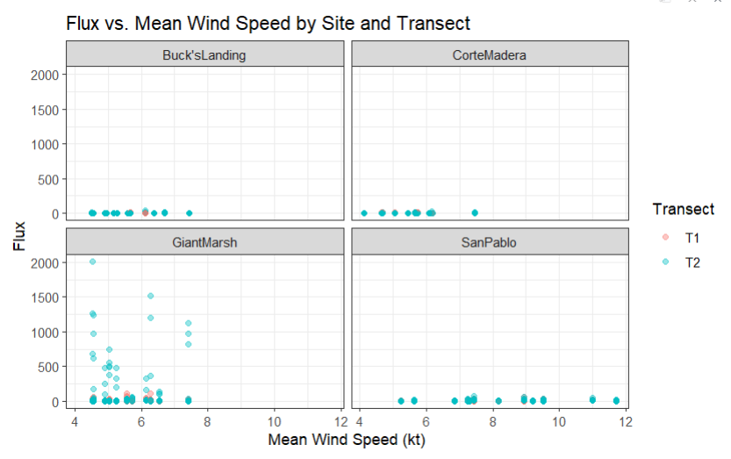
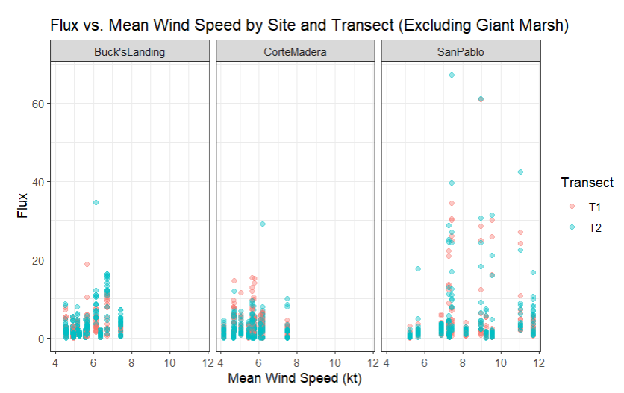
Appendices (Descriptive Data): Wind Speed

Slide 18
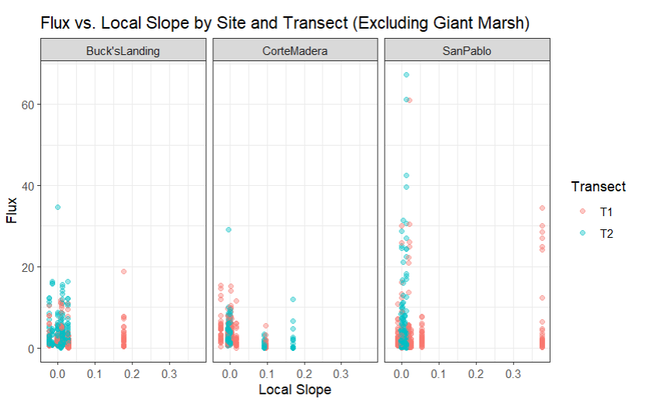
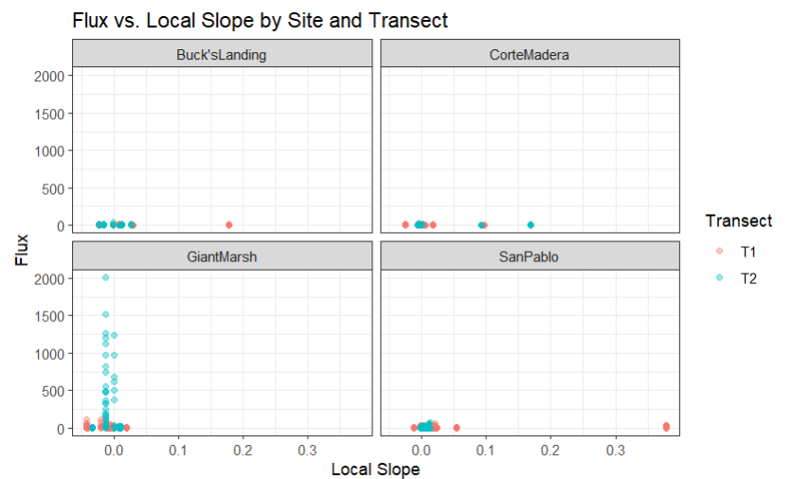
Appendices (Descriptive Data): Slope
Local Slope

Slide 19
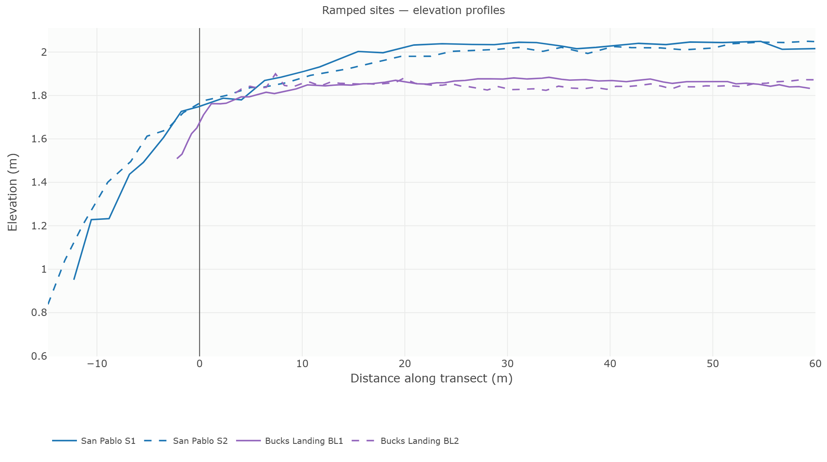
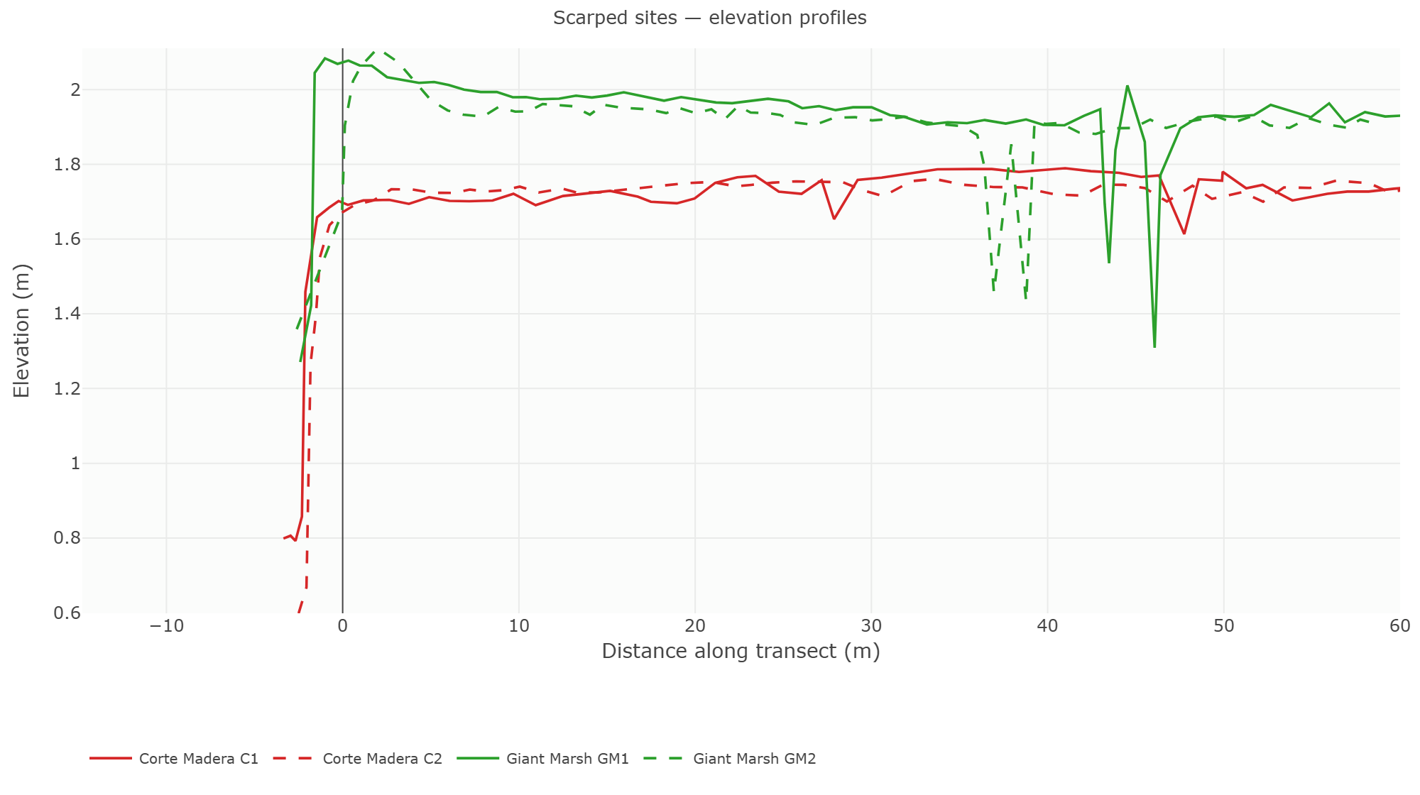
Appendices (Descriptive Data): Elevation Profile
Ramped Sites
(San Pablo and Buck’s Landing)
Scarped Sites
(Corte Madera and Buck’s Landing)

